Slide 1


Amateur Extra Licensing Class
Digital Excitement with Computers & Radios
Presented by
W5YI
Arlington, Texas

Slide 2
Amateur Radio Extra Class
Element 4 Course Presentation
ELEMENT 4 Groupings
  Rules & Regs
  Skywaves & Contesting
  Outer Space Comms
  Visuals & Video Modes
  Digital Excitement with Computers & Radios
  Modulate Your Transmitters
  Amps & Power Supplies
  Receivers with Great Filters

Slide 3
Amateur Radio Extra Class
Element 4 Course Presentation
ELEMENT 4 Groupings
  Oscillate & Synthesize This!
  Circuits & Resonance for All!
  Components in Your New Rig
  Logically Speaking of Counters
  Optos & OpAmps Plus Solar
  Test Gear, Testing, Testing 1,2,3
  Antennas
  Feedlines & Safety

Slide 4
Amateur Radio Extra Class
Digital Excitement with Computers & Radios
E2E01… A common method of transmitting data emissions below 30 MHz is FSK/AFSK.
E2E06… The most common data rate used for HF packet communications is 300 baud.
E2D03… When comparing HF and 2-meter packet operations, HF packet typically uses FSK (Frequency Shift Keying) with a data rate of 300 baud; 2-meter packet uses AFSK (Audio Frequency Shift Keying) with a data rate of 1200 baud.

Slide 5
Amateur Radio Extra Class
Digital Excitement with Computers & Radios
E2D09… Under clear communication conditions 300 baud packet digital communications mode has a faster data throughput than AMTOR; 170-Hz shift; 45 baud RTTY; and PSK31.
E2D02… The definition of “baud” is the number of data symbols transmitted per second.
The baud rate can be higher than the bit rate if more than one parameter of the signal is changed during transmission, such as amplitude, width, or phase.
E2E11… Baudot code is the “International Telegraph Alphabet Number 2” (ITA2) which uses five data bits.

Slide 6
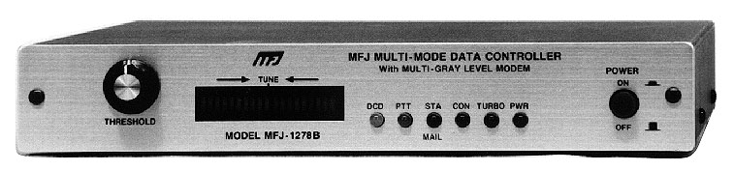
Amateur Radio Extra Class
Digital Excitement with Computers & Radios
E2D01… The “command mode” in packet operations means the TNC is ready to receive instructions via the keyboard.
Example TNC commands and responses
cmd:port
PORT 2
cmd:myc
MYCALL W5GB-7/W5GB-7
cmd:f
FLOW OFF
cmd:conm
CONMODE TRANS
cmd:

Slide 7
Amateur Radio Extra Class
Digital Excitement with Computers & Radios
E2E08… The PACTOR HF digital mode can be used to transfer binary files.
E8C02… Some of the differences between the Baudot digital code and ASCII are; Baudot uses five data bits per character and ASCII uses seven; Baudot uses two characters as shift codes, ASCII has no shift code.
E2E02… The letters FEC as they relate to digital operation stand for Forward Error Correction
In telecommunication, forward error correction (FEC) is a system of error control for data transmission, whereby the sender adds redundant data to its messages, also known as an error correction code. This allows the receiver to detect and correct errors (within some bounds) without the need to ask the sender for additional data. The advantage of forward error correction is that a back-channel is not required, or that retransmission of data can often be avoided, at the cost of higher bandwidth requirements on average. FEC is therefore applied in situations where retransmissions are relatively costly or impossible.

Slide 8
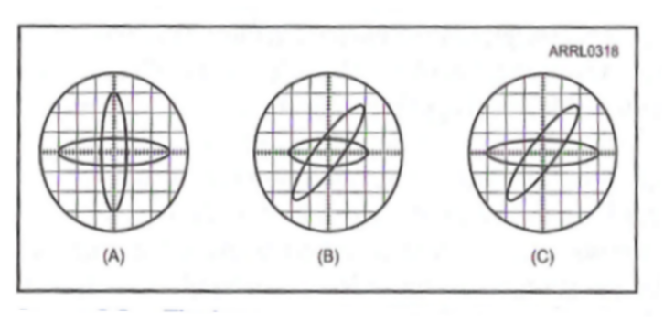
Amateur Radio Extra Class
Digital Excitement with Computers & Radios
E2E03… Forward Error Correction is implemented by transmitting extra data that may be used to detect and correct transmission errors
E2E05… If errors are detected in an AMTOR Mode A transmission, ARQ (Automatic Repeat Request) accomplishes error correction by requesting a retransmission.
E2E04… Selective fading has occurred when one of the ellipses in an FSK crossed-ellipse display suddenly disappears.

Slide 9
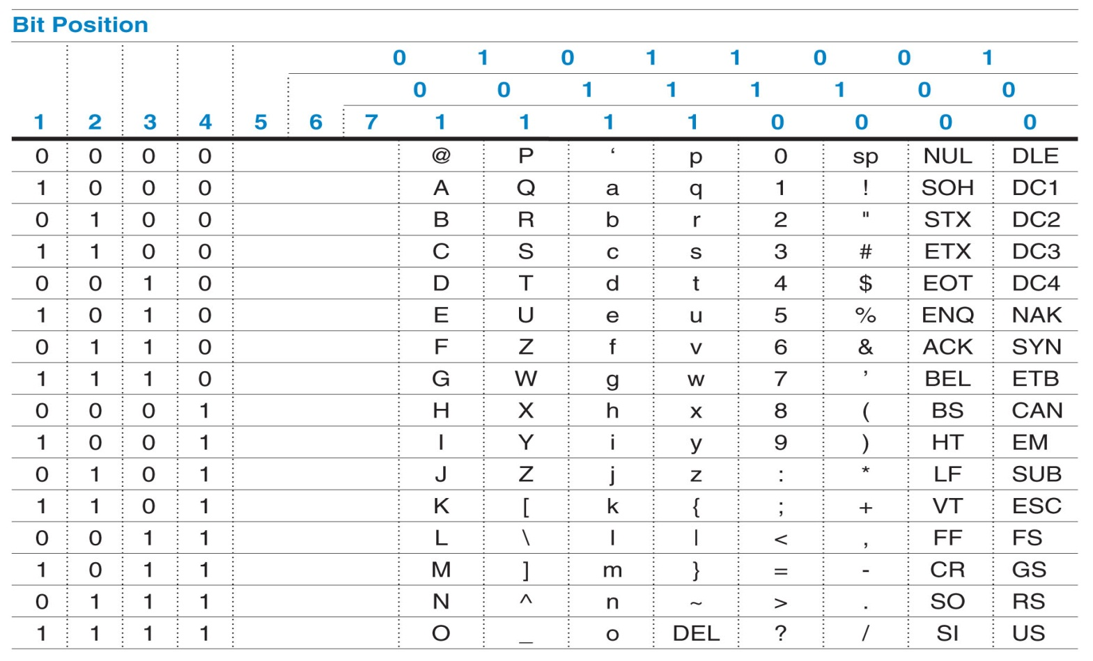
Amateur Radio Extra Class
Digital Excitement with Computers & Radios
E8C03… One advantage of using ASCII code for data communications is that it is possible to transmit both upper and lower case text.
E8C14… The advantage of including a parity bit with an ASCII character stream is that some types of errors can be detected.

Slide 10
Amateur Radio Extra Class
Digital Excitement with Computers & Radios
E8C07… The necessary bandwidth of a 170-hertz shift, 300-baud ASCII transmission is 0.5 kHz (or 500Hz).
E8C08… The necessary bandwidth of a 4800-Hz frequency shift, 9600-baud ASCII FM transmission is 15.36 kHz.
E8C05… Sinusoidal data pulses are used to minimize the bandwidth requirements of a PSK-31 signal.
  - Angular shapes (square, sawtooth) require harmonics, which increase bandwidth
E2E09… The PSK31 HF digital mode uses variable-length coding for bandwidth efficiency.
E2E07… The typical bandwidth of a properly modulated MFSK16 signal is 316 Hz.
E2E12… The digital communication mode having the narrowest bandwidth is PSK31.

Slide 11
Amateur Radio Extra Class
Digital Excitement with Computers & Radios
E4A09… Adjusting the ALC Level is most important when adjusting PSK31 transmitting levels.
E8C15… One advantage of using JT-65 coding is virtually perfect decoding of signals well below the noise.
JT65 is a digital protocol intended for Amateur Radio communication with extremely weak signals. It was designed to optimize Earth-Moon-Earth (EME) contacts on the VHF bands, and conforms efficiently to the established standards and procedures for such QSO’s.
E2D10… An APRS station with a GPS unit can automatically transmit information showing a mobile station's position in support of a public service communications activity.
E2D07… AX.25 digital protocol is used by APRS.
      APRS is described as AX.25

Slide 12
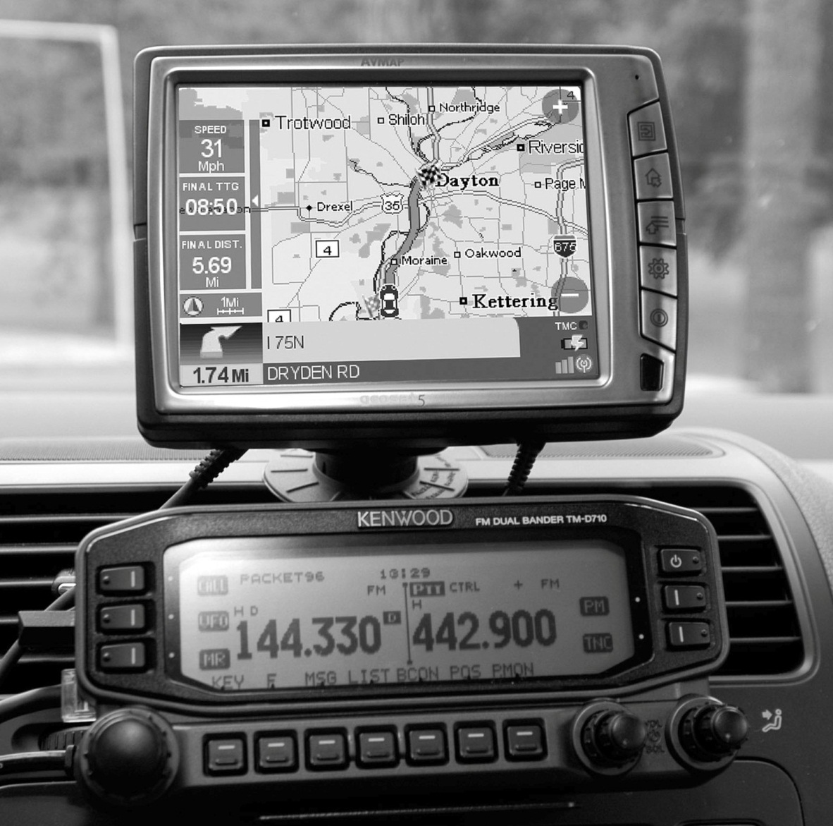
Amateur Radio Extra Class
Digital Excitement with Computers & Radios
E2D08… Unnumbered Information frames are the packet frame type used to transmit APRS beacon data.
Kenwood dual bander plugged into the Avmap G5 GPS position plotter.

Slide 13
Amateur Radio Extra Class
Digital Excitement with Computers & Radios
E2D11… Any one of the following data sources can be used to accurately transmit your geographical location over the APRS network:
  The NMEA-0183 formatted data from a Global Positioning System (GPS) satellite receiver
  The latitude and longitude of your location, preferably in degrees, minutes and seconds, manually entered into the APRS computer software
  The NMEA-0183 formatted data from a LORAN navigation system
E2D06… 144.39 MHz is a commonly used 2-meter APRS frequency.
E8C09… The term Spread-spectrum communication describes a wide-bandwidth communications system in which the transmitted carrier frequency varies according to some predetermined sequence.
E1F01… Spread spectrum transmissions are permitted only on amateur frequencies above 222 MHz.

Slide 14
Amateur Radio Extra Class
Digital Excitement with Computers & Radios
E8C10… A spread-spectrum technique causes a digital signal to appear as wide-band noise to a conventional receiver.
E8C11… Frequency hopping is a spread-spectrum communications technique alters the center frequency of a conventional carrier many times per second in accordance with a pseudo-random list of channels.
E8C12…A direct sequence spread-spectrum communications technique uses a high speed binary bit stream to shift the phase of an RF carrier.
E8C13…Spread-spectrum communications are resistant to interference because only signals using the correct spreading sequence are received.

Slide 15
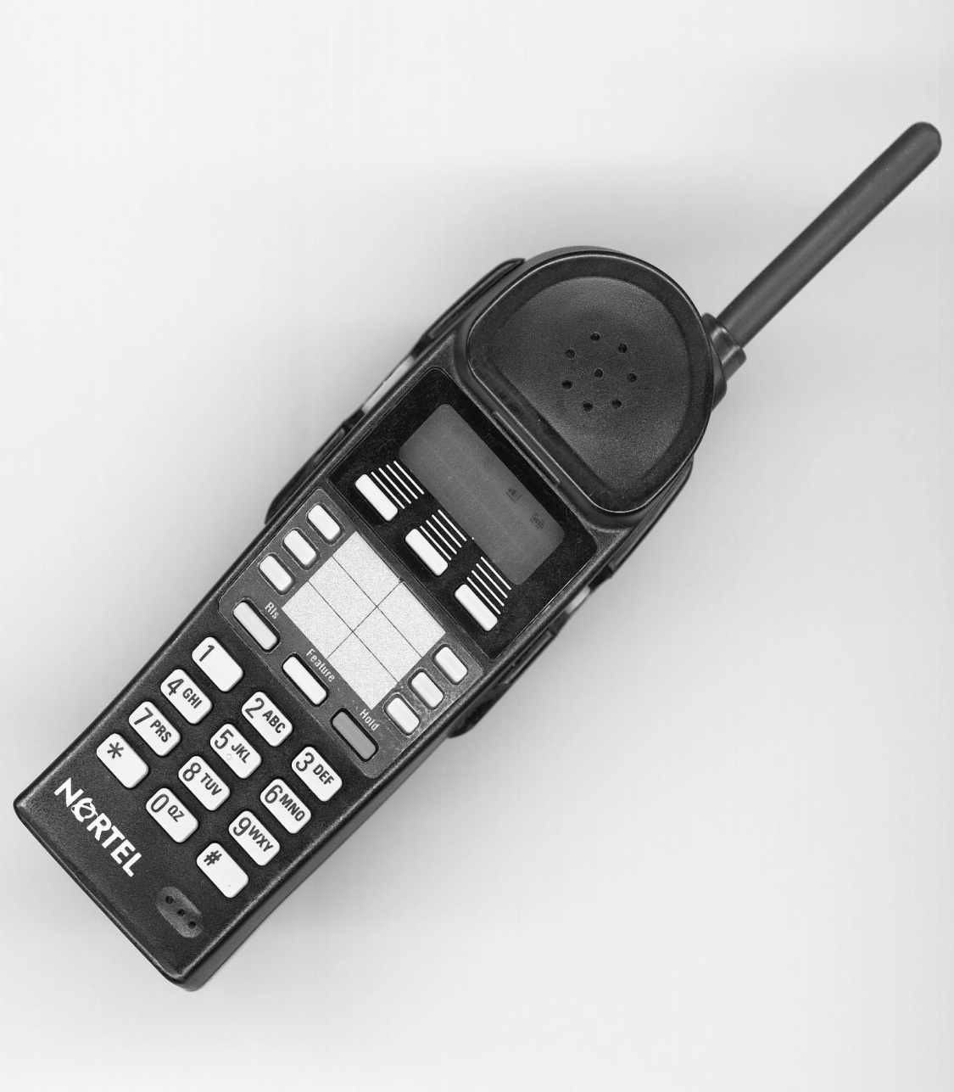
Amateur Radio Extra Class
Digital Excitement with Computers & Radios
E2C09… The frequency hopping (FH) spread-spectrum technique works by rapidly changing the transmit frequency of the transmitting station according to a particular pseudo random sequence. The same pseudo-random sequence is known and is time synchronized with the receiving station.
900MHz cordless phones use spread-spectrum technology.

Slide 16




Amateur Radio Extra Class
Digital Excitement with Computers & Radios
E2C08… Spread-spectrum signals are resistant to interference because any signals not using the spectrum-spreading algorithm are suppressed in the receiver.
E1F12… FCC-licensed amateur stations may use spread spectrum (SS) emissions to communicate when the other station is in an area regulated by the FCC, when the other station is in a country permitting SS communications and when the transmission is not used to obscure the meaning of any communication.
F5
F4
F2
F1
F6
F3
Frequency Hopping Spread Spectrum

Slide 17
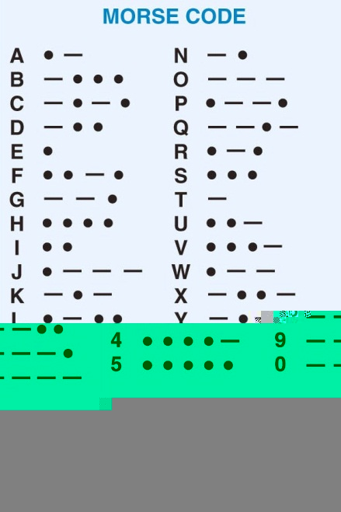
Amateur Radio Extra Class
Digital Excitement with Computers & Radios
E8C01… Morse code is a digital code consisting of elements having unequal length.
E8C06… The necessary bandwidth of a 13-WPM international Morse code transmission is approximately 52 Hz.

Slide 18

Element 4 Extra Class
Question Pool
Digital Excitement with Computers & Radios
Valid July 1, 2008
Through
June 30, 2012

Slide 19
E2E01 What is a common method of transmitting data emissions below 30 MHz?
DTMF tones modulating an FM signal
FSK/AFSK
Pulse modulation
Spread spectrum

Slide 20
E2E06 What is the most common data rate used for HF packet communications?
48 baud
110 baud
300 baud
1200 baud

Slide 21
E2D03 Which of the follow is true when comparing HF and 2-meter packet operations?
HF packet typically uses FSK with a data rate of 300 baud; 2-meter packet uses AFSK with a data rate of 1200 baud
HF packet and 2-meter packet operations use different codes for information exchange
HF packet is limited to Amateur Extra class amateur licensees; 2-meter packet is open to all but Novice Class amateur licensees
HF and 2-meter packet operations are both limited to CW/Data-only band segments

Slide 22
E2D09 Under clear communications conditions, which of these digital communications modes has the fastest data throughput?
AMTOR
170-Hz shift, 45 baud RTTY
PSK31
300-baud packet

Slide 23
E2D02 What is the definition of “baud”?
The number of data symbols transmitted per second
The number of characters transmitted per second
The number of characters transmitted per minute
The number of words transmitted per minute

Slide 24
E2E11 What is the Baudot code?
A code used to transmit data only in modern computer-based data systems using seven data bits
A binary code consisting of eight data bits
An alternate name for Morse code
The International Telegraph Alphabet Number 2 (ITA2) which uses five data bits

Slide 25
E2D01 What does “command mode” mean in packet operations?
Your computer is ready to run packet communications software
The TNC is ready to receive instructions via the keyboard
Your TNC has received a command packet from a remote TNC
The computer is ready to be set up to communicate with the TNC

Slide 26
E2E08 Which of the following HF digital modes can be used to transfer binary files?
Hellschreiber
PACTOR
RTTY
AMTOR

Slide 27
E8C02 What are some of the differences between the Baudot digital code and ASCII?
Baudot uses four data bits per character, ASCII uses seven; Baudot uses one character as a shift code, ASCII has no shift code
Baudot uses five data bits per character, ASCII uses seven; Baudot uses two characters as shift codes, ASCII has no shift code
Baudot uses six data bits per character, ASCII uses seven; Baudot has no shift code, ASCII uses two characters as shift codes
Baudot uses seven data bits per character, ASCII uses eight; Baudot has no shift code, ASCII uses two characters as shift codes

Slide 28
E2E02 What do the letters FEC mean as they relate to digital operation?
Forward Error Correction
First Error Correction
Fatal Error Correction
Final Error Correction

Slide 29
E2E03 How is Forward Error Correction implemented?
By the receiving station repeating each block of three data characters
By transmitting a special algorithm to the receiving station along with the data characters
By transmitting extra data that may be used to detect and correct transmission errors
By varying the frequency shift of the transmitted signal according to a predefined algorithm

Slide 30
E2E05 How does ARQ accomplish error correction?
Special binary codes provide automatic correction
Special polynomial codes provide automatic correction
If errors are detected, redundant data is substituted
If errors are detected, a retransmission is requested

Slide 31
E2E04 What is indicated when one of the ellipses in an FSK crossed-ellipse display suddenly disappears?
Selective fading has occurred
One of the signal filters has saturated
The receiver has drifted 5 kHz from the desired receive frequency
The mark and space signal have been inverted

Slide 32
E8C03 What is one advantage of using the ASCII code for data communications?
It includes built-in error-correction features
It contains fewer information bits per character than any other code
It is possible to transmit both upper and lower case text
It uses one character as a shift code to send numeric and special characters

Slide 33
E8C14 What is the advantage of including a parity bit with an ASCII character stream?
Faster transmission rate
The signal can overpower interfering signals
Foreign language characters can be sent
Some types of errors can be detected

Slide 34
E8C07 What is the necessary bandwidth of a 170-hertz shift, 300-baud ASCII transmission?
0.1 Hz
0.3 kHz
0.5 kHz
1.0 kHz

Slide 35
E8C08 What is the necessary bandwidth of a 4800-Hz frequency shift, 9600-baud ASCII FM transmission?
15.36 kHz
9.6 kHz
4.8 kHz
5.76 kHz

Slide 36
E8C05 What technique is used to minimize the bandwidth requirements of a PSK-31 signal?
Zero-sum character encoding
Reed-Solomon character encoding
Use of sinusoidal data pulses
Use of trapezoidal data pulses

Slide 37
E2E09 Which of the following HF digital modes uses variable-length coding for bandwidth efficiency?
RTTY
PACTOR
MT63
PSK31

Slide 38
E2E07What is the typical bandwidth of a properly modulated MFSK16 signal?
31 Hz
316 Hz
550 Hz
2 kHz

Slide 39
E2E12 Which of these digital communications modes has the narrowest bandwidth?
MFSK16
170-Hz shift, 45 baud RTTY
PSK31
300-baud packet

Slide 40
E4A09 Which of the following is most important when adjusting PSK31 transmitting levels?
Power output
PA current
ALC level
SWR

Slide 41
E8C15 What is one advantage of using JT-65 coding?
Uses only a 65 Hz bandwidth
Virtually perfect decoding of signals well below the noise
Easily copied by ear if necessary
Permits fast-scan TV transmissions over narrow bandwidth

Slide 42
E2D10 How can an APRS station be used to help support a public service communications activity?
An APRS station with an emergency medical technician can automatically transmit medical data to the nearest hospital
APRS stations with General Personnel Scanners can automatically relay the participant numbers and time as they pass the check points
An APRS station with a GPS unit can automatically transmit information to show a mobile station's position during the event
All of these choices are correct

Slide 43
E2D07 Which of the following digital protocols is used by APRS?
AX.25
802.11
PACTOR
AMTOR

Slide 44
E2D08 Which of the following types of packet frames is used to transmit APRS beacon data?
Connect frames
Disconnect frames
Acknowledgement frames
Unnumbered Information frames

Slide 45
E2D11 Which of the following data sources are needed to accurately transmit your geographical location over the APRS network?
The NMEA-0183 formatted data from a Global Positioning System (GPS) satellite receiver
The latitude and longitude of your location, preferably in degrees, minutes and seconds, entered into the APRS computer software
The NMEA-0183 formatted data from a LORAN navigation system
Any of these choices is correct

Slide 46
E2D06 Which of the following is a commonly used 2-meter APRS frequency?
144.20 MHz
144.39 MHz
145.02 MHz
146.52 MHz

Slide 47
E8C09 What term describes a wide-bandwidth communications system in which the transmitted carrier frequency varies according to some predetermined sequence?
Amplitude compandored single sideband
AMTOR
Time-domain frequency modulation
Spread-spectrum communication

Slide 48
E1F01 On what frequencies are spread spectrum transmissions permitted?
Only on amateur frequencies above 50 MHz
Only on amateur frequencies above 222 MHz
Only on amateur frequencies above 420 MHz
Only on amateur frequencies above 144 MHz

Slide 49
E8C10 Which of these techniques causes a digital signal to appear as wide-band noise to a conventional receiver?
Spread-spectrum
Independent sideband
Regenerative detection
Exponential addition

Slide 50
E8C11 What spread-spectrum communications technique alters the center frequency of a conventional carrier many times per second in accordance with a pseudo-random list of channels?
Frequency hopping
Direct sequence
Time-domain frequency modulation
Frequency compandored spread-spectrum

Slide 51
E8C12 What spread-spectrum communications technique uses a high speed binary bit stream to shift the phase of an RF carrier?
Frequency hopping
Direct sequence
Binary phase-shift keying
Phase compandored spread-spectrum

Slide 52
E8C13 What makes spread-spectrum communications resistant to interference?
Interfering signals are removed by a frequency-agile crystal filter
Spread-spectrum transmitters use much higher power than conventional carrier-frequency transmitters
Spread-spectrum transmitters can hunt for the best carrier frequency to use within a given RF spectrum
Only signals using the correct spreading sequence are received

Slide 53
E2C09 How does the spread-spectrum technique of frequency hopping (FH) work?
If interference is detected by the receiver it will signal the transmitter to change frequencies
If interference is detected by the receiver it will signal the transmitter to wait until the frequency is clear
A pseudo-random binary bit stream is used to shift the phase of an RF carrier very rapidly in a particular sequence
The frequency of the transmitted signal is changed very rapidly according to a particular sequence also used by the receiving station

Slide 54
E2C08 Why are received spread-spectrum signals resistant to interference?
Signals not using the spectrum-spreading algorithm are suppressed in the receiver
The high power used by a spread-spectrum transmitter keeps its signal from being easily overpowered
The receiver is always equipped with a digital blanker circuit
If interference is detected by the receiver it will signal the transmitter to change frequencies

Slide 55
E1F12 FCC-licensed amateur stations may use spread spectrum (SS) emissions to communicate under which of the following conditions?
When the other station is in an area regulated by the FCC
When the other station is in a country permitting SS communications
When the transmission is not used to obscure the meaning of any communication
All of these choices are correct

Slide 56
E8C01 Which one of the following digital codes consists of elements having unequal length?
ASCII
AX.25
Baudot
Morse code

Slide 57
E8C06 What is the necessary bandwidth of a 13-WPM international Morse code transmission?
Approximately 13 Hz
Approximately 26 Hz
Approximately 52 Hz
Approximately 104 Hz

